Slide 1

App Deployment 101
Deploy your Python App on Heroku

Slide 2
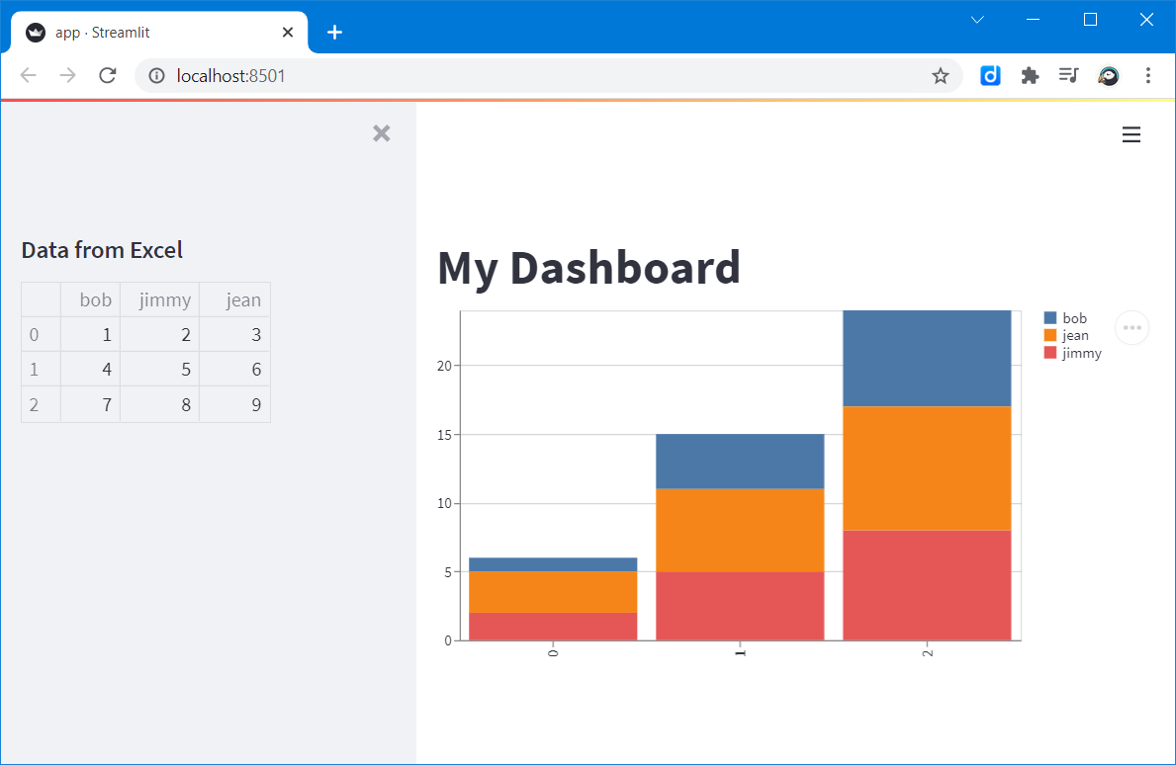
Outcome
At the end of this training, you should be able to deploy the following web app to Heroku.

Slide 3
Agenda
Get started with programming in Python
01
Develop your first web app with Streamlit
02
Deploy with Git & Heroku
03

Slide 4
1. Get started with programming in Python
Download Python: https://www.python.org/
Why Python: Number 1 language according to TIOBE index
Open Terminal, and run python:
>>> print("Hello World")

Slide 5



Slide 6
2. Develop your first web app with Streamlit
Install via PIP (package manager for Python):
$ pip install streamlit
Or if you cannot find pip:
$ python3 -m pip install streamlit
Develop your first app.py:
import streamlit as st
st.write(“Hello World!”)

Slide 7
Outcome
At the end of this training, you should be able to deploy the following web app to Heroku.

Slide 8
3. Deploy with Git & Heroku
Learn the basics about source control with Git: https://git-scm.com/
Heroku tutorial: https://devcenter.heroku.com/articles/getting-started-with-python
Required files
setup.sh
Procfile
requirements.txt

Slide 9


Slide 10
Deploy the app
$ heroku login
$ heroku create
$ git push heroku main

Slide 11
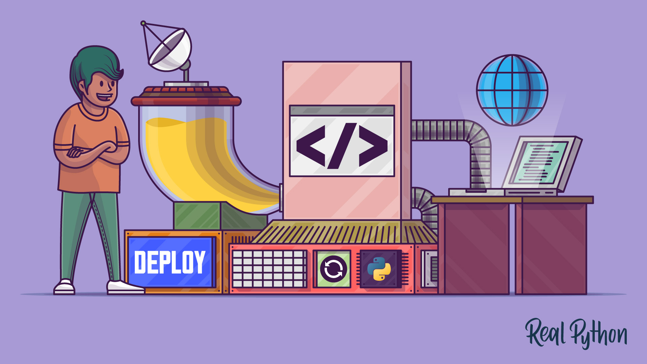
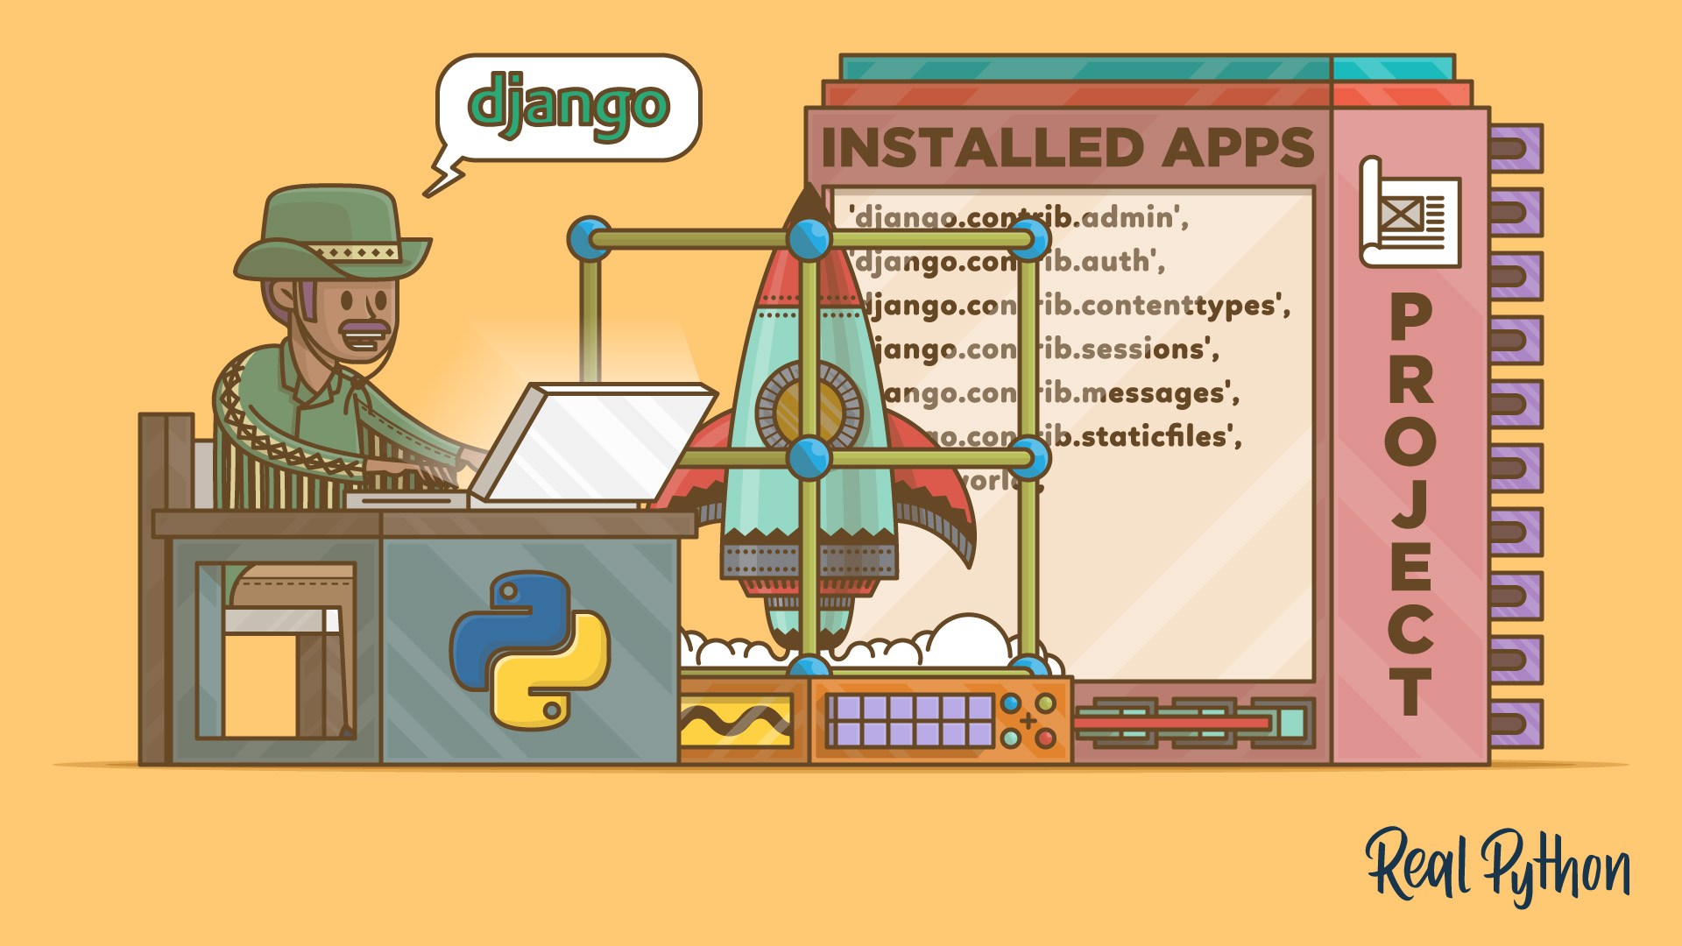
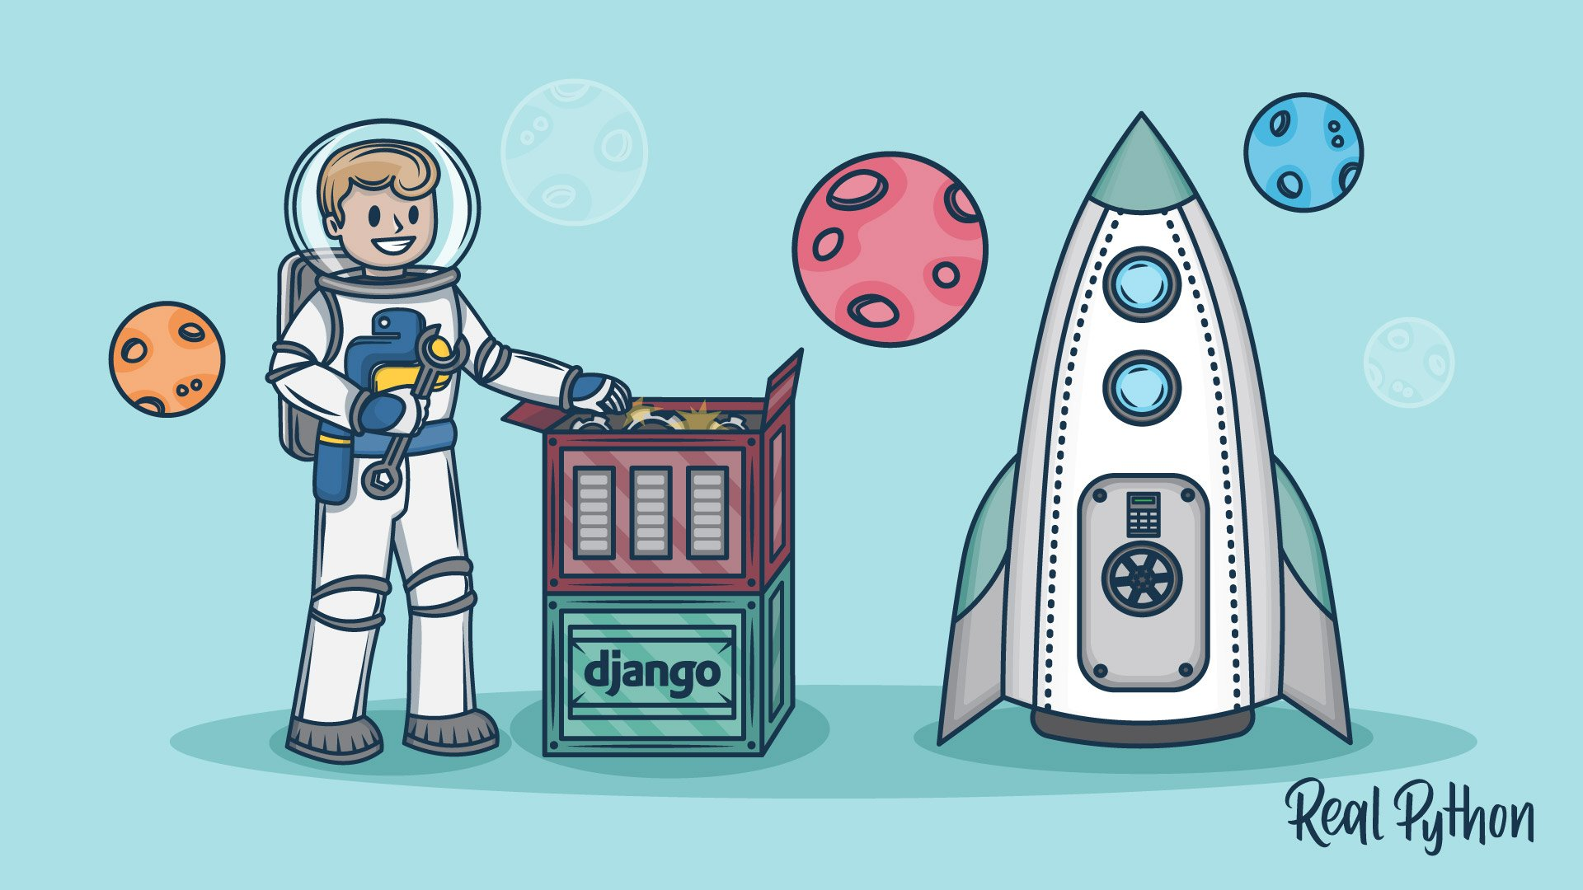
Before Streamlit Other web frameworks
Flask
Django
https://realpython.com/django-setup/
https://realpython.com/python-web-applications/
https://realpython.com/get-started-with-django-1/

